Slide 2
Microsoft Teams Architecture Update
Bill Bliss
Microsoft Teams Platform Architect
BRK3215

Slide 3
High-level client + services architecture

Slide 4
Teams joins O365 with Intelligent Communications
Teams Clients
Office 365 platform and services
Teams Services
Intelligent Communications Cloud
Azure

Slide 5


Teams Client Architecture (Today)
Optimized for agility
Auto-updates
Desktop
Mobile
Web
Windows
Mac
iPhone/iPad
Android
Electron
iOS
Android
C++
Objective C
HTML5/CSS
Angular → React
jQuery, lodash, etc. (200+ Open Source Components)
Swift
Java
TypeScript, Node, SASS
(Some) React Native
Browsers: Edge, IE11, latest Chrome, latest Firefox, Safari
Desktop: Windows 10, 8.1, 7(SP1), Mac OS X 10.10+

Slide 6
Teams services
Teams Services
Often referred to as the “Middle Tier” although it is actually a collection of microservices
More efficient / Less complex
Scale flexibility
Lower risk / deployment agility
Optimize for evolutionary change
Front end servers
Identity
Team Mgmt
Auth
Admin
AAD sync
Extensibility
Compliance
Tabs
Audit
Graph
Retention
Bots
Notifications
Config
Email
Settings store

Slide 7
Intelligent Communications Cloud
Intelligent Communications Cloud (formerly Skype) Services
Leverage the next generation compliant skype services for messaging and VOIP calling
PSTN calling and conferencing leverages the Skype for Business Online stack
Presence to leverage the new unified presence services
Messaging
Calling /Meeting
Chat
Calling service
Call recording
Media
Transport relays
Voicemail
Search
Media processor
Trouter
URL preview
Media controller
Meeting scheduler
Notification Hub
Registrar
Personal Expression
People
Config
Identity
Presence
Experimentation
Skype Identity
Permission service

Slide 8
Teams and Office 365
Office 365
Teams strives to realize the full benefits of O365 both as a platform and for end user capabilities
A part of our vision is to be an App hub for Office 365 and bring together the best capabilities
Teams does not aim to re-invent the wheel, instead leverages the features of other O365 workloads
Platform
Applications
Exchange
OneNote
Modern Groups
PowerApps
SharePoint
Planner
Stream
PowerPoint, Word, Excel
OneDrive for Business
Information Protection
Data and analytics
Microsoft Power BI

Slide 9
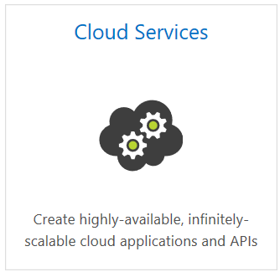
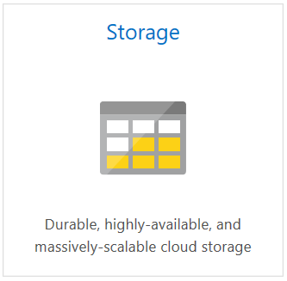
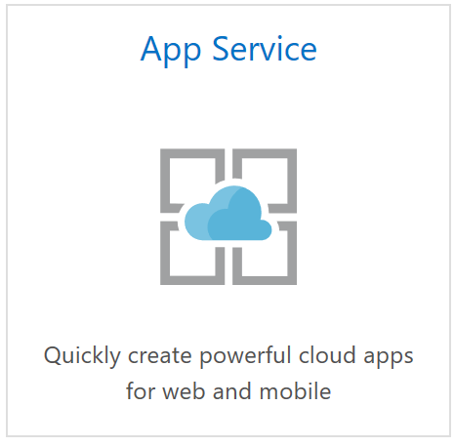
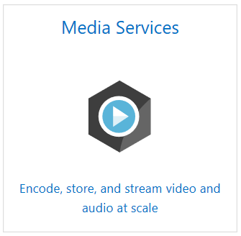
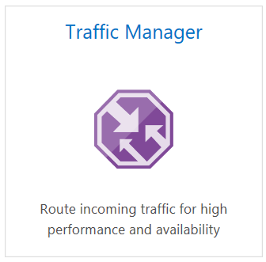
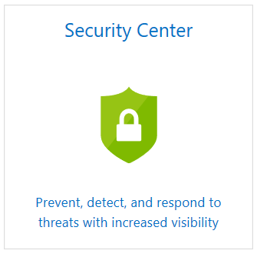
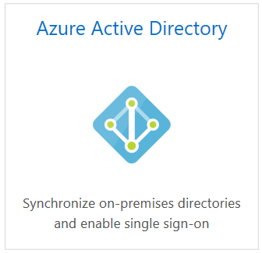
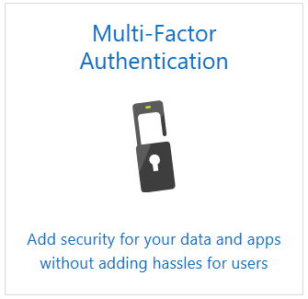
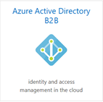
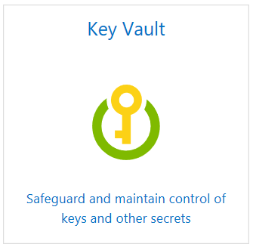
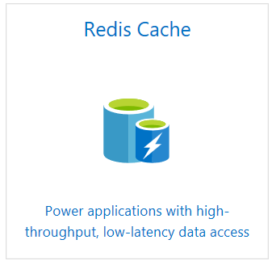
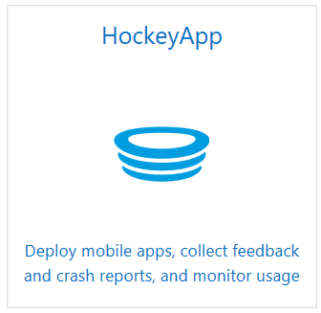
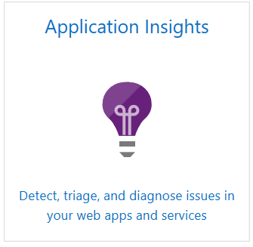
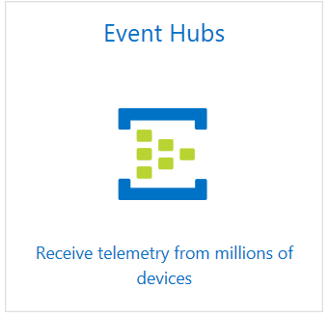
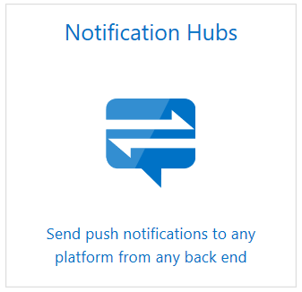
Teams and Azure Services
Azure
Azure is the core platform that Teams is built on (cloud-first)
Massive scale support
Global footprint
Redundancy and Disaster recovery
Compliance

Slide 10

Deployment and data residency
In region
In country
US Gov
Microsoft Teams. If Customer provisions its tenant in Australia, Canada, the European Union, India, Japan, the United Kingdom, or the United States,
Microsoft will store the following Customer Data at rest only within that Geo:
Microsoft Teams chats, Team conversations, images, voicemail, and contacts
SharePoint Online site content and the files stored within that site
files uploaded to OneDrive for Business
AMERICAS
EMEA
APAC
Dublin
UK West
UK South
Canada east
Amsterdam
North Central US
Canada central
Japan East
US Gov Arizona
East US
Japan West
US Gov Texas
East Asia
West India
Central India
Southeast Asia
Australia East
Australia Southeast
181 countries | 33 languages
(NOTE: Hebrew and Arabic RTL languages now supported)

Slide 11
High level architecture: one level deeper
Microsoft Teams
Intelligent Communications
Microsoft 365 Core services
Teams Clients
Web
Desktop
iOS
App
Android
App
Graph API
Electron
Services
Web
Companions
Audio /
video
Telemetry
Settings and
O365 access
Messaging
Notes
Files
Files
Other Workloads
OneNote
WAC
OneDrive for Business
SharePoint
Experimentation
Teams services
Chat & Presence services
Calling / Meeting
AAD
MRU
Most recent files
Policy
Exchange
Calendar
Bots
PSTN
Connectors
Publish / Subscribe
Stream Recording
Graph Webhook
Push Notifications
Exchange
Search
Notification service
Information Protection
Email service
SMTP

Slide 12
Messaging Architecture and Data Storage

Slide 13
Messaging (1:1, 1:M, Channels)
Secure, fast, reliable
Teams Client
Images
message Long poll
messages
Message sync
Media service
Real-time Notifications
Chat Service
Aggregation service
Roster
Member
Thread
Message
Annotations
App platform
Publish / subscribe
Email service
Notification service
Push notifications
Exchange
Graph Webhook
Search

Slide 14
Post a message (1:1, 1:M, channel)
User A
device 1
User B
Device 2
Active, just logged in
User B
Device 3
Active, already logged in
User B
IOS Device 4
Not active
User B
Android Device 5
Not active
1
Post a message
2
Sync messages to client
3
Long poll messages to client
3
5
6
1
2
5
Notify subscribers
Apple
Google
4
5
IOS Push notifications
Chat Service
Real-time notifications
Push notifications
6
Android Push notifications
Messaging Publish / Subscriber
4
Exchange
Search Index
Notification
Service
Graph Webhook
Activity Feed
Federation Gateway
Audit Log
Bot Listener
Augmentation service
Information Protection

Slide 15

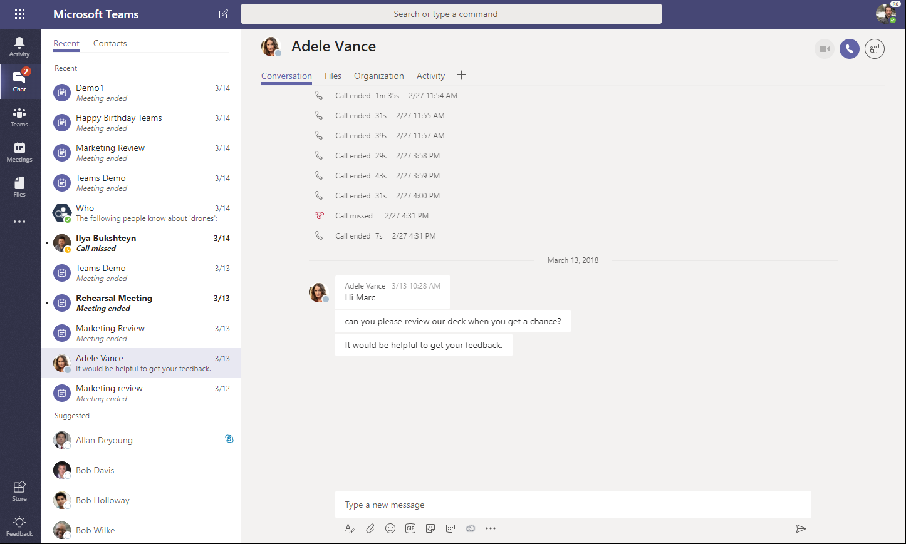
Conversation storage
Where are conversations stored?
Chat service
In memory processing for speed
Leverages Azure storage (blob, tables, queues), moving to Cosmos DB
Substrate / Exchange
Chat and channel messages are also stored in Exchange for information protection
Conversation images & media
Inline Images/Stickers are stored in a media store; Giphys are not stored

Slide 16
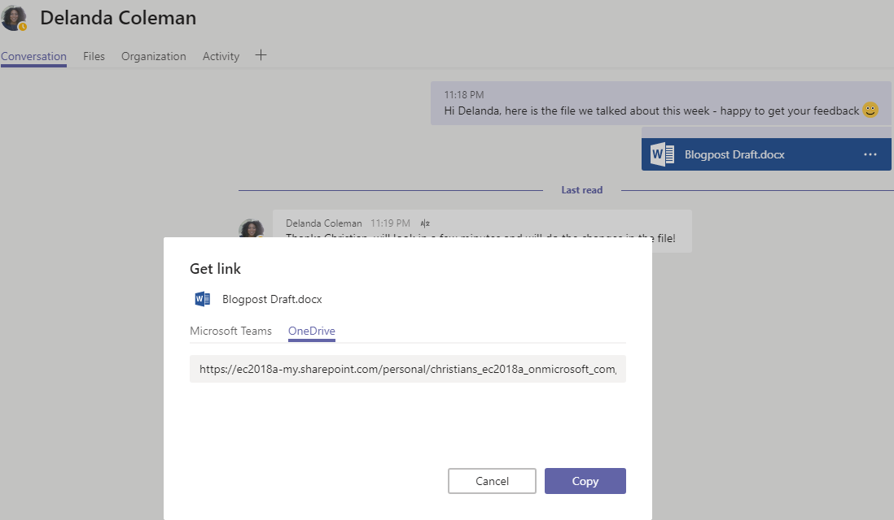
File storage
Where are files stored?
1:N chats
Files are uploaded to OneDrive for Business and permissions are set for the members of the chat
Team conversations
Files are uploaded to SharePoint. A folder is associated with each channel in the team
Cloud storage
Dropbox, Box, Citrix ShareFile, Google Drive

Slide 17
Data Entity Storage
Key data entities and location where data is stored at rest
Entity
Storage
Storage
Message
Chat service table storage (moving to Cosmos DB)
Ingested to Exchange to enable compliance
Image
Media service on Azure (using Blob storage)
Ingested to Exchange to enable compliance
Files
Team files → SharePoint
Chat files → OneDrive for Business
Voicemail
Individual mailbox in Exchange
Recording
Media service on Azure (using Blob storage) (<24 hours)
Encoded to Stream
Calendar meeting
Individual mailbox in Exchange
Contacts
Exchange
Telemetry
Microsoft Data warehouse (No customer content)

Slide 18
Meetings, Calendar, and Presence

Slide 19
Calendar Architecture
Exchange Online
Teams Client
Calendar Middle Tier
Scheduling service
Chat service
Exchange on-premises

Slide 20
Meetings
Seamless
High Quality
Outlook Client
Teams Client
Teams Meeting add-in
Calendar
Calendar (via MS Graph)
Messages
Voice / Video
Stream Recording
Exchange
Chat Service
Intelligent Communications services
Media service
Stream
Transcoded Recording
Recording
Media mixer
Recording Bot
In Outlook, a meeting is an appointment item with extra properties
In Teams, a meeting is a group chat with extra properties
Shared between them are "meeting coordinates" – metadata used to bind Intelligent Communications services

Slide 21


Messaging and Presence Interop
1:1 chats
Text only
User A
User B
CHAT
Presence
Presence
1
Post a message
6
2
Route message via Message Gateway
1
4
3
3
Long poll, sync or push notification to client
Chat services
Presence
Skype for Business Presence
Skype for Business Chat services
publish
PRESENCE
7
4
Set presence to SfB
subscribe
publish
5
Subscribe and publish presence
2
5
publish
6
Get Presence
message
Message Gateway
message
7
Set presence to Teams
subscribe
message
Skype for Business
on-premise Presence
Skype for Business
on-premise Chat services
User C
6
3
message
Presence

Slide 22
Meeting recording
User A
User B
Teams Client
Teams Client
1
User starts recording
2
Recorder is added to call
1
Add participant
7
Sync recording link
8
Stream recording
3
Recorder (Azure service) records call
Meeting service
Chat service
Microsoft Stream
4
Recorder sends data to media service
5
Media service transcodes video and uploads to Microsoft Stream
6
Recorder sends message with link to recording
2
Call recorder bot
6
Post message with link to recording
5
Publish
7
User(s) receive message on client
Recorder
8
User(s) stream the recording
3
4
export
Media service

Slide 23
Calling

Slide 24
Client calling stacks
No plugin required (ORTC/WebRTC)
Common code between Mac and Windows
Improved quality with latest bits on all clients
Desktop
Mobile
Web
client
UI (HTML, CSS)
UI (HTML, CSS)
UI (HTML, CSS)
calling service
calling service
calling service
ts-calling “ICall" API
SlimCore Wrapper
SlimCore Wrapper
Notification Stack
TRAP client
call handler
native code
SlimCore
SlimCore
native code
shared
component
ts-calling
JS CSA
JavaScript Media Agent
shared
component
ORTC/ WebRTC
browser
relays
Registrar
Trouter
Conversation Service
Media Controller
ChatService
services
TPC
Call Controller
Media Processor

Slide 25
Calling
Next Generation services for VOIP
Leverage Skype for Business services for PSTN
Teams Clients
message sync
create call, join call, …
incoming notifications
Roster, Transfer,
Renegotiate
register as callable endpoint
messages
media
Chat Service
Conversation Service
Notification service
Media Services
Call Controller
Registrar
Skype for Business Online services
call state
messages
client notifications
callable endpoints?
incoming call notification
SfB Resource Forest
Policy store
Voice Gateway
SfB User Forest
Settings Policy
Calling SfB Interop / PSTN

Slide 26
Teams on VDI (Virtual Desktop Infrastructure)

Slide 27
Teams on VDI: High Level Architecture
Goal. Create a performant VDI implementation that will work seamlessly for multiple partners
Approach. Augment Teams by injecting functionality to allow Audio/Video (A/V) to be remoted. Specifically:
WebRTC function overrides. For example, RTCPeerConnection() creates the connection on the Thin Client instead of VM, allowing A/V to stream directly between the Remote Client and the Thin Client
Mirrored A/V elements. Allows changes in Teams running on the VM to be represented on the Thin Client
Partner VM implementation. Contains a secure connection to the Thin Client, allowing VM to be notified about A/V events on the Thin Client

Slide 28
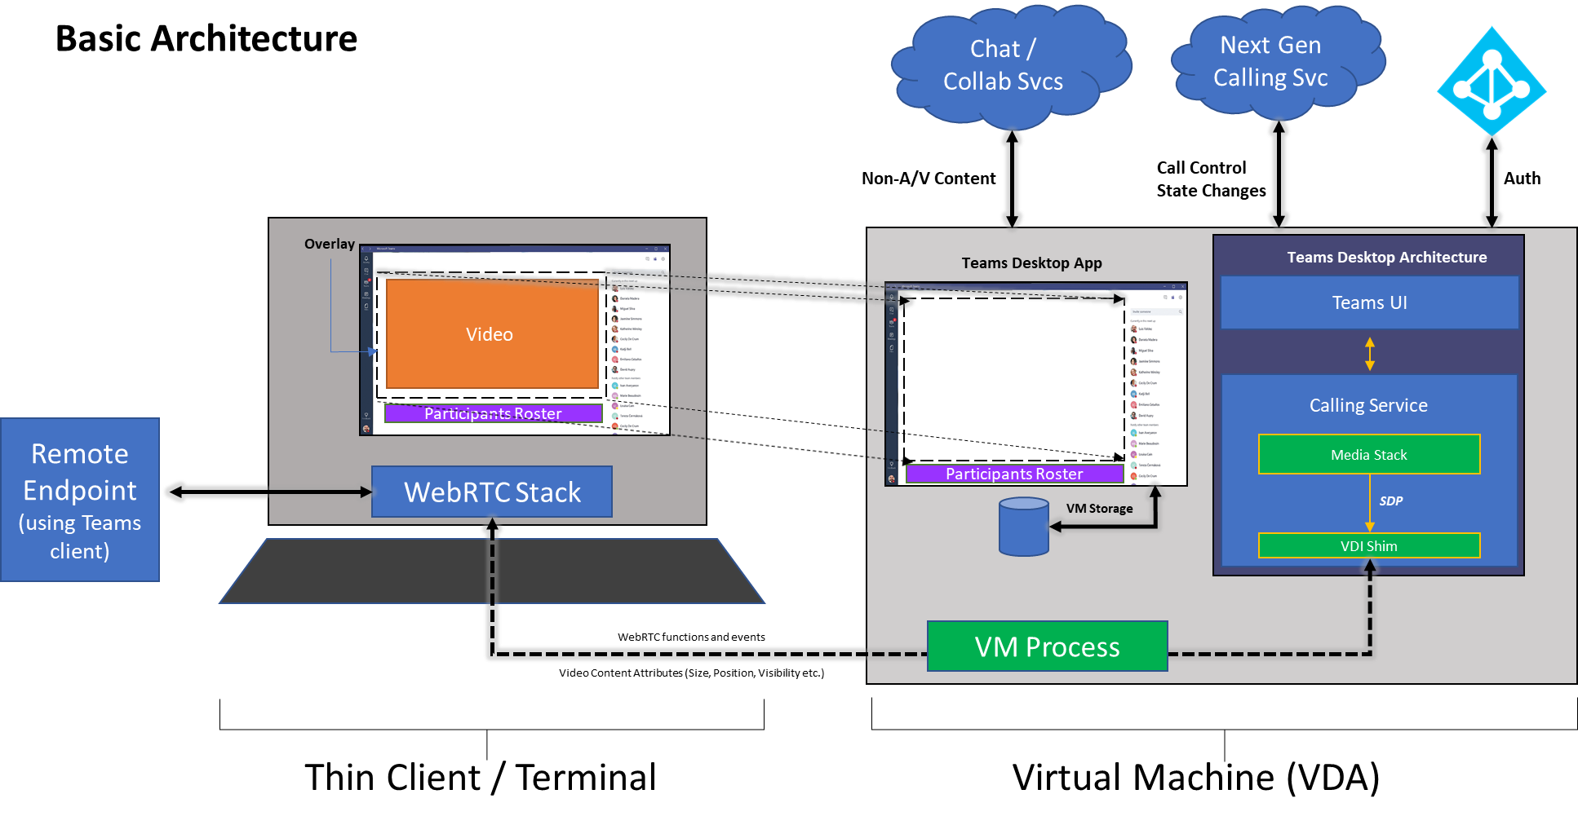
Teams for VDI: High Level Architecture (Cont.)

Slide 29
Teams on VDI: Installation and Packaging
Teams on VDI is packaged as a special MSI image. Implications:
If Teams is already installed (via EXE, MSI, or Office Pro Plus), it must be uninstalled first
Installation steps
Sign into Teams using a browser
From a new browser window/tab, download the 32-bit or 64-bit MSI
Use one of the following commands to install the Teams desktop client MSI using the per-machine mode:
msiexec /i Teams_windows.msi /l*v msi_install.log ALLUSER=1
msiexec /i Teams_windows_x64.msi /l*v msi_install_x64.log ALLUSER=1
Updates are manual:
Uninstall:
msiexec /passive /x Teams_windows.msi /l*v msi_uninstall.log
msiexec /passive /x Teams_windows_x64.msi /l*v msi_uninstall_x64.log
Repeat installation steps

Slide 30
Teams on VDI: Implementation Details
Support for P2P calling Audio/Video streams uses WebRTC. During of calling service initialization, if Teams is running in a VDI environment, WebRTC calling stack is used instead of native Teams calling stack
During initialization, the following functions are replaced by VDI Partner implementations:
window.webkitRTCPeerConnection() – Create peer connection
navigator.getUserMedia() – get user media shim
navigator.mediaDevices.enumerateDevices() – enumerate devices shim
navigator.mediaDevices.getDisplayMedia() – get display media shim
Multiparty calls and 1:1 Call Escalation to multiparty calls use this flow as well. With multi-party calls, the peer connection connects the Thin Client to the Meeting Server

Slide 31
Teams on VDI: A/V Mirroring
Virtual Machine
Thin Client
Peer Connection
Functions
RTCPeerConnection
Events
Audio Element
SrcObject, SinkId
Audio Element
Hidden, Paused
Video Element
Size, Fit, SrcObject, SinkId
Video Element
Hidden, Paused
Enumerate Devices
Query
Enumerate Devices
Result
Microphone
Camera
Misc Device

Slide 32
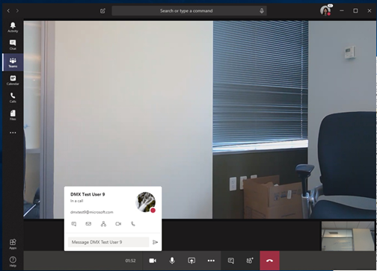
Element Occlusion: Contact Card

Slide 33
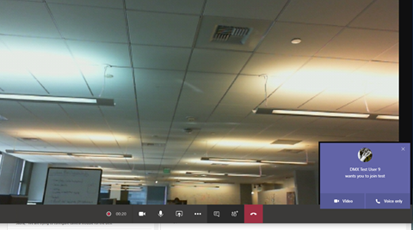
Window Occlusion
It is possible for other windows on the VM to also create occlusion situations. This occurs when a window is moved on top of the Teams application when video is being rendered. It is the responsibility of the VDI partner implementation to track the windows on the VM, including their Z order, and to cut the overlay as necessary to see the other windows.
This is true even for Teams notification windows as seen at left.

Slide 34
Limitations and Unsupported Features
​Limitations
Single video view
Unsupported Features
App sharing
Give/Take control in App/Screen Sharing
Background blur
Share System Audio
Disable auto-start
Incoming call ring without Citrix remote audio
Emoji animations
QoS metrics

Slide 35
Information Protection and the Compliance Boundary

Slide 36
Data flows and the compliance boundary
The compliance boundary is where Microsoft can manage the security and privacy of customer data
compliance boundary
Connectors
Data posted to a channel
User Browser, Desktop ,Mobile
Email a channel
Data posted to a channel
Standard Teams user
Giphy
Query to Giphy
Guest added
via AAD B2B
Guest user
Microsoft Teams
Push Notifications (Mobile)
Push notifications to Apple or Google to notify mobile client *
Anonymous user
joining a meeting
Anonymous join to a meeting
Other Cloud storage (3rd party)
Optional Box, Dropbox, Google drive, Citrix ShareFile
URL Preview
Get a preview of a URL that is posted to a message
Communication between multiple tenants
Federation communication
Tabs
Any third-party tab is hosted outside the compliance boundary
Apps/Bots
Any third-party App/bot or line of business app is hosted outside the compliance boundary
Graph API
Graph APIs can be exposed to line of business apps or 3rd party apps
Calling Plan (PSTN)
Enables inbound/outbound calling outside the organization
Key
2-way communication
Inbound data
Outbound data

Slide 37








How Teams enables O365 Information Protection
Email
1:1 chats
Group chats
Channel messages
O365 Information Protection tools
eDiscovery
Legal Hold
Compliance content search
Archive
Retention
Audit Logs
Microsoft
Teams
Chat
service
O365
services
SharePoint Files
OneNote/Wiki
OneDrive for Business

Slide 38
All New! training, certification and tools
For Microsoft 365 developers
You can find Microsoft 365 developer training modules on Microsoft Learn!
https://aka.ms/M365DevTraining
Free for Ignite 2019 participants!
Become Microsoft 365 Certified! Earn a Developer Associate certification
Exam MS-600: Building Applications and Solutions with Microsoft 365 Core Services (beta)
Get 80% off during beta period - receive full credit!
Join the Office 365 Developer Program! Get the new Microsoft 365 E5 dev subscription, sample data packs and more great tools
https://aka.ms/IgniteO365DevProgram

Slide 39
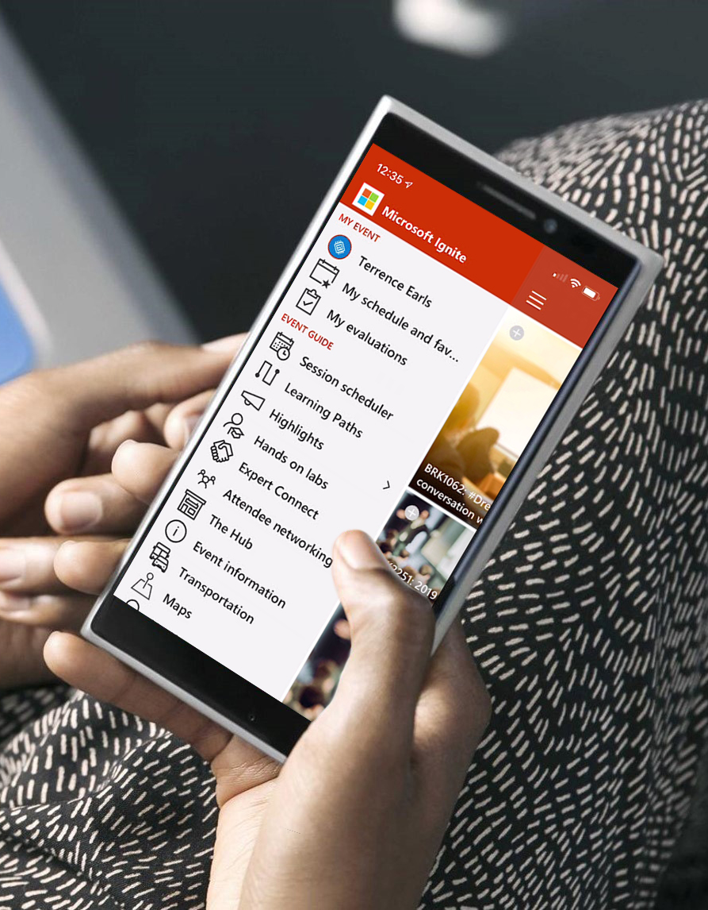
Please evaluate this session Your feedback is important to us!
Please evaluate this session through MyEvaluations on the mobile app or website.
Download the app: https://aka.ms/ignite.mobileapp
Go to the website: https://myignite.techcommunity.microsoft.com/evaluations

Slide 40
Visit aka.ms/MicrosoftIgnite2019/BRK3215
Download slides and resources
Access session recordings in 48 hours
Ask questions & continue the conversation
Find this session in Microsoft Tech Community

